Slide 1

VEL TECH HIGH TECH Dr. RANGARAJAN Dr. SAKUNTHALA ENGINEERING COLLEGE An Autonomous Institution
Department of Information Technology
IOT BASED MULTI-PATTERN FINGERPRINT SECURITY SYSTEM
Student 1 Name: Nithyanantham.R
Student 2 Name: Panbarasan.T.A
Student 3 Name: Arvindhan.G
II Year, Information Technology
Supervisor
Name :Ms.S.Mangalapriya
Designation : A.P/IT

Slide 2
IOT BASED MULTI-PATTERN FINGERPRINT SECURITY SYSTEM
Introduction:
Nowadays security system becomes more advanced as application of technologies increases
Earlier there was the type of registration method, username and password method, biometric security method which includes fingerprint, iris, face recognition.
On each security system ,it has equal amount of pros and cons which lesser the efficiency of security system

Slide 3


DRAW BACKS
Pin based security system : more combinations of input ,but not unique
Biometric based security system: less number of combination on input data,but all are unique

Slide 4
IOT BASED MULTI-PATTERN FINGERPRINT SECURITY SYSTEM
Objective:
It is a security system which is more secured based biometric detail in multiple pattern of input of it which gives unique number of pattern of ways to user, enabling secured access.
On the proposed pattern, there are 625 ways of input patternization is given, as an advancement on input data .From the proposed pattern ,it consists of 5 inputs from fingers on one hand
This is to provide a advanced security system which could enhance the security of one person’s bank locker and also in military warehouses and more.

Slide 5
IOT BASED MULTI-PATTERN FINGERPRINT SECURITY SYSTEM
Block Diagram/Flowchart:
Fingerprint scanner
Arduino UNO R3 along with ESP-32 module
Web interface
Database
Matching score
Through ESP32
- Creation
- Verification
- Response

Slide 6
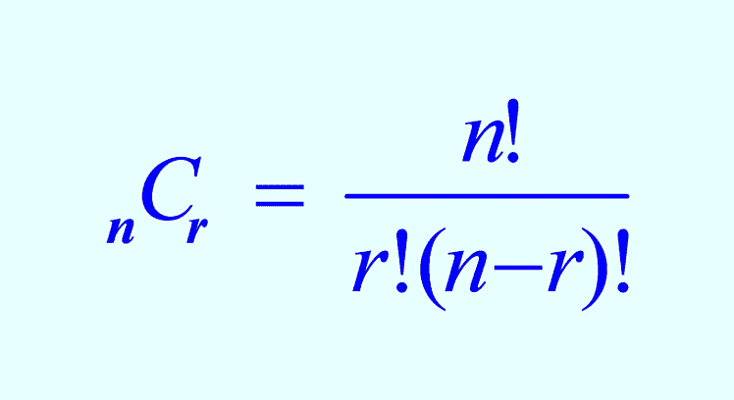
Combination of data
No of combination on input pin:10*10*10*10=10000 ways
No of ways of input on Biometric system :1unique way
No of ways of input on proposed idea:625 unique ways
combinatorics

Slide 7
Storing and retrieving biometric data
Each data are stored and linked with copy of previous data
Data 1
Data 2
Data 3
Data 4
Copy of pre=0
Copy of pre
Copy of pre
Copy of pre

Slide 8
IOT BASED MULTI-PATTERN FINGERPRINT SECURITY SYSTEM
Requirements (Materials/Components, Hardware/Software):
Arduino Uno rev.3
ESP-32 module
Fingerprint sensor
Arduino IDE in c language
LCD display
Connecting two pin sockets
DC 12v 2apm power supply adaptor

Slide 9
Conclusion
On implementing multi-pattern fingerprint system ,we increase the efficiency of the existing model.On the basis of combinations and uniqueness of the data.
Patternization algorithm can be implemented through previously mentioned data storing and retrieving process .

Slide 10
Thank you

